Slide 1
END-TO-END AUTOMATION • AGENT-DRIVEN
We set up a Revit model
without ever opening Revit or AutoCAD.
An AI agent owns the entire Planet Fitness project kickoff, from inbox to a fully configured, circuited, synced cloud model.
20-25 hr
<1 hr
4-5 hr
20+
manual setup, before
with supervised agent
saved per project
pre-built Revit ops

Slide 2






THE PIPELINE
Six stages, one agent.
Email Intake & Discovery
01
AutoCAD Processing (COM)
02
Cloud Infrastructure
03
Scans Outlook for legit kickoffs from Jack, Babafemi, Scott; filters follow-ups & noise
Extracts project name, downloads & renames DWGs (XO→X_BG, TB→X_TB)
Falls back to ACC folders when attachments are missing; checks what's already done
Opens DWGs, extracts title block + block coords + gridlines to CSV
Unlocks layers, deletes demo, rebases blocks 5×
AI block-rename detection scans every definition against its label, no hardcoded maps
Verifies speakers / fans / smoke detectors land on the correct MEP layers
Spins up Revit cloud models in ACC from template via APS API (2-legged OAuth)
Uploads DWGs + CSVs to the right ACC project folder
Opens cloud models via ExternalEvent for safe UI-thread execution
Revit Model Setup (MCP)
04
MEP Automation
05
Utilities & Toolkit
06
Links CAD background, greys layers across all views, centers scope boxes & equipment
Populates title block (name, address, project #, sq ft) + state-based cert numbers
Parses revisions, resets viewport positions, builds gridlines from CAD
Places Revit spaces from coord CSV with auto-tagging
Imports YAML equipment profiles into Revit ExtensibleStorage
Places every electrical fixture from CSV, auto-maps CAD blocks → YAML labels
Super Circuit V5: headless circuit assignment with overflow logic across panels
Syncs the workshared model to central
ACC bulk-check, MEP layer audit, standalone block-rename fixer
Pure COM extractors, no .dxex templates needed
AutoCAD COM toolkit w/ IMessageFilter, reconnect, progress-aware iteration
20+ pre-built Revit ops + color-splash QA + Crystallize → permanent pyRevit buttons

Slide 3


WHAT CHANGED
Manual checklist → one conversation.
4 to 5 hours saved in project setup alone
BEFORE
NOW
Est. 20 to 25 hours per project
Under 1 hour, supervised agent
Outlook, ACC, AutoCAD, Revit, pyRevit: five apps deep
Endless copy-paste between CSVs, sheets, and parameters
Manual block renames, layer audits, gridline rebuilds
Circuiting one panel at a time, by hand
Agent owns the inbox, ACC, CAD, the cloud, and Revit
AI catches block mismatches per-project, no static maps
Headless circuiting w/ overflow logic across panels
Human only confirms at checkpoints
The point: the agent doesn't just assist the workflow, it is the workflow.

Slide 4
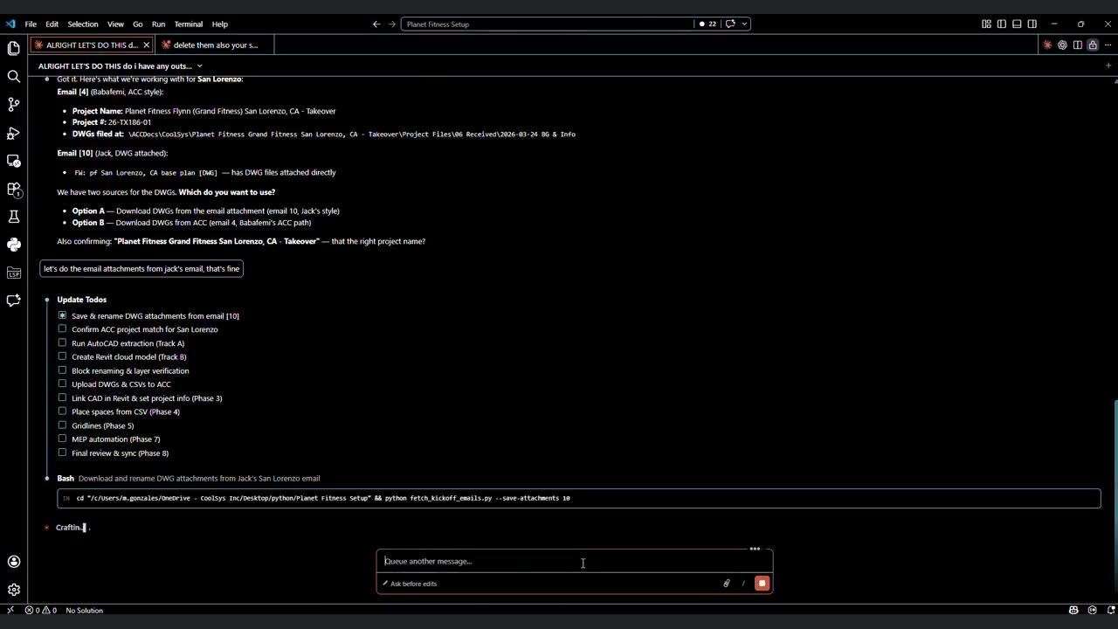
LIVE RUN
60 minute convo (condensed to 30 sec)
Click play. Full project kickoff start to finish, 26x speed, no human keystrokes inside Revit or AutoCAD.

